Slide 1
Analysis of Sales Data Using Machine Learning in Python
Garrett Amstutz | Samson Haile | Kieran Nehil-Puleo | Benjamin Wurst
Notes:
Garrett

Slide 2
Questions
Parameters:
Time of day
Day of the year
Discount on price
Goal:
We want to build a model to predict quantity using machine learning algorithms
How does time of year, time of day, and discount affect the quantity of crab legs sold
Notes:
Samson

Slide 3
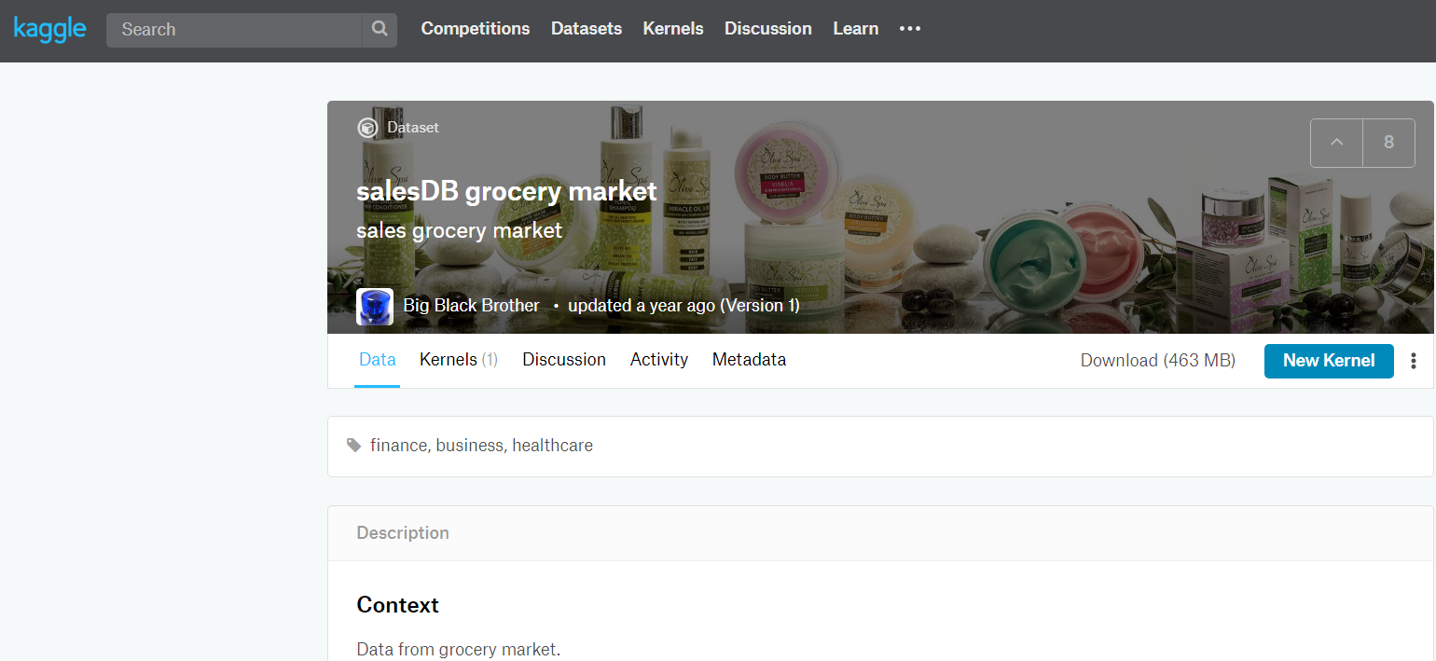
Background: Data Exploration
Data comes from a Kaggle project (2018)
Contains sales data on numerous variables across multiple files
Product
Price
Quantity
Store location
Customer
Employee
Sales date and time
Picture of the kaggle website page
Notes:
Garrett

Slide 4
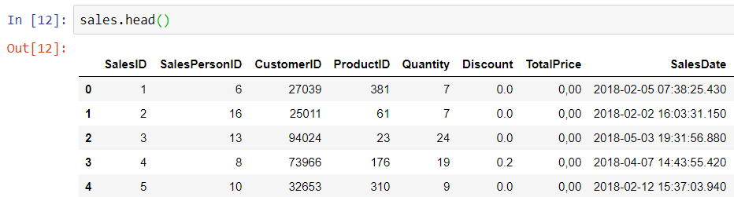
Background: Data Exploration
Whole data set was 6.7
million transactions
300+ MB
Broke excel + JupyterHub
Mix of useful/not so useful information
Total Price was not actually in the dataset
Transaction number provided nothing
Notes:
Garrett

Slide 5
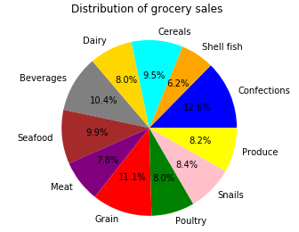
Background: Data Exploration
Grocery data
11 categories | 400+ products
Fairly even splits for each category of product
Most common: confections (sweets)
Least common: shellfish
Each category contained products of varying quantities
Notes:
Garrett

Slide 6
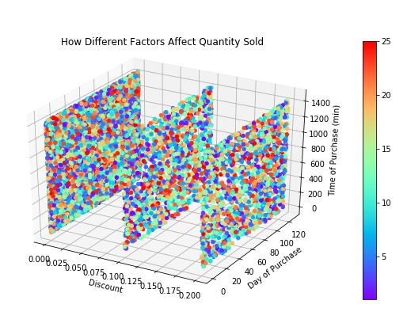
Background: Data Exploration
Crab Legs
Relationship between Discount, Quantity, and time and day of purchase
Did not find the patterns we were hoping for
Hypothetical data
One more graph related to just crab whatever we picked
Notes:
Garrett

Slide 7
Methods: Data
Comma Separated File
Masked from the 6 million data set using pandas
Data types were altered for easy use for the machine learning algorithms
Datetime types
Removed incomplete data
The data set was split into a training and testing set
Notes:
Samson

Slide 8
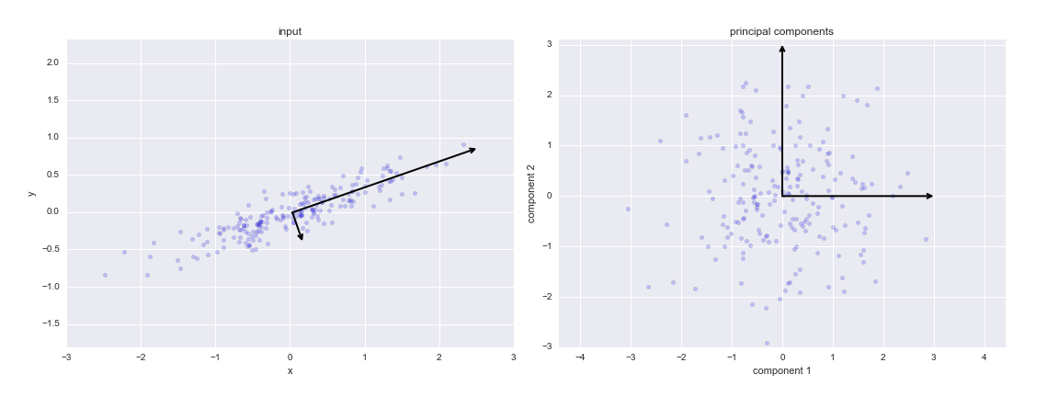
Methods: Machine Learning - PCA
What is PCA
Why do we use it
Sklearn decomposition
Notes:
Kieran

Slide 9
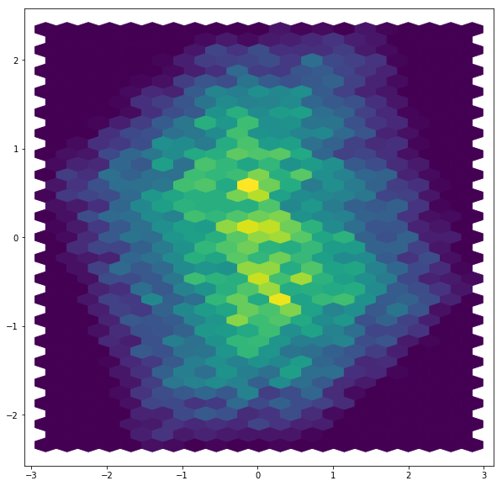
Results: PCA
Here’s what’s important based on PCA
Explains Variance of linear combinations of variables
Dimension reduction
Unsupervised Machine Learning
Look at this graph i made you
Principal components were nearly identical in variance value which indicates data generation
Notes:
Kieran

Slide 10
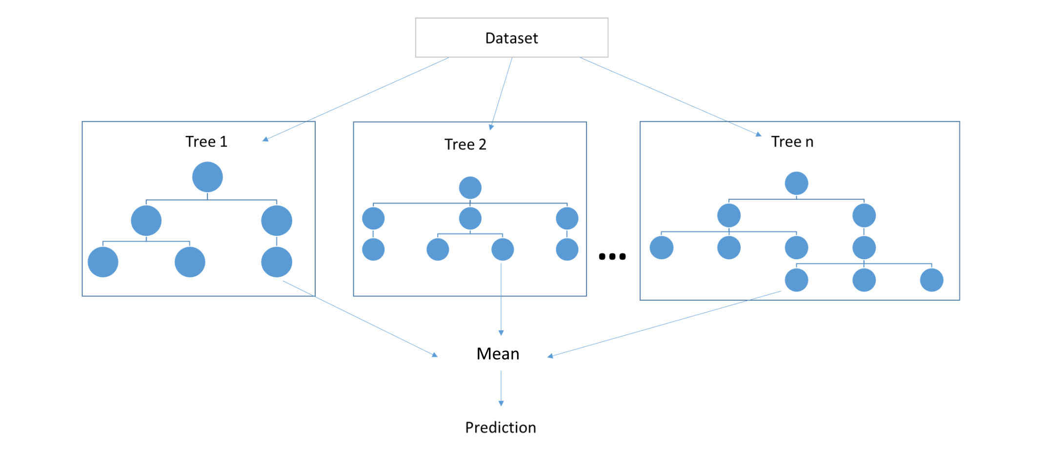
Methods: Machine Learning - Random Forest
Random forest is a machine learning method for regression or classification
The forest is a collection of many trees
Result is an average
We can vary the number of levels we let the tree grow
The concept of a decision tree and the method for making predictions
Notes:
Ben

Slide 11
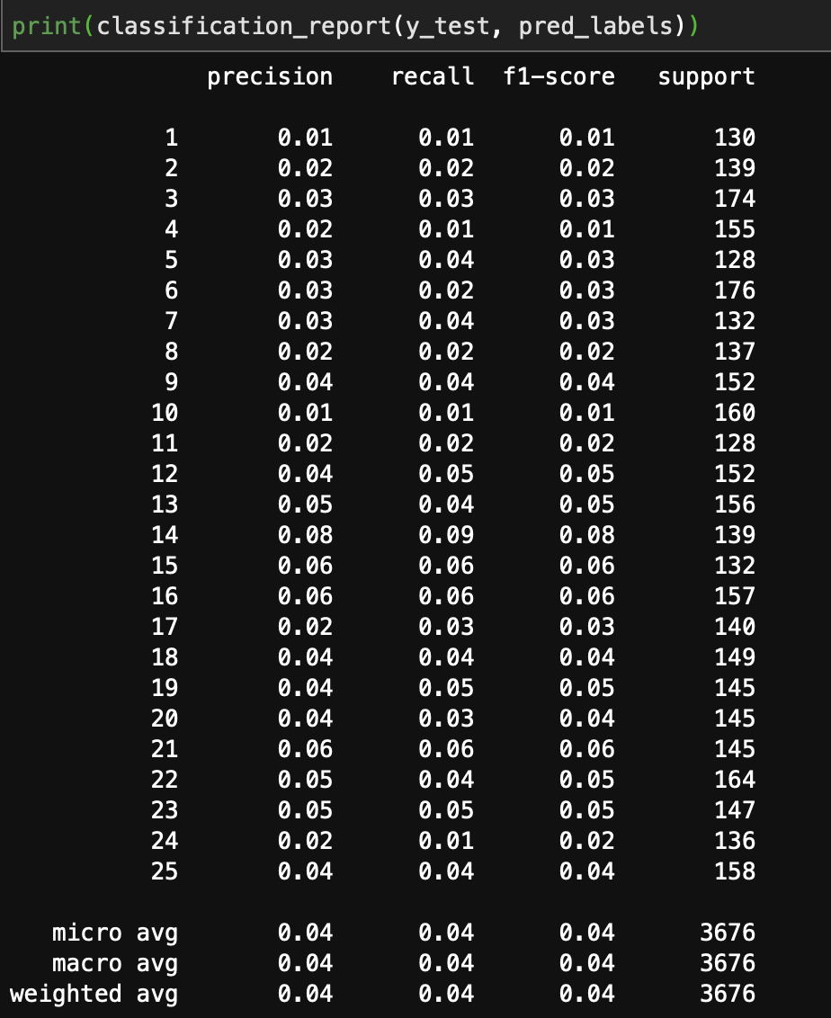
Results: Random Forest
We tried combinations of different numbers of trees and levels
More levels improved the precision
Once we used 100 trees, any more did not improve any results
The testing set of data was 3676 transactions
We noticed that each of the quantities had an even distribution of instances
This suggests the data is completely random
The results of an average of 100 trees with 500 levels
Notes:
Ben

Slide 12
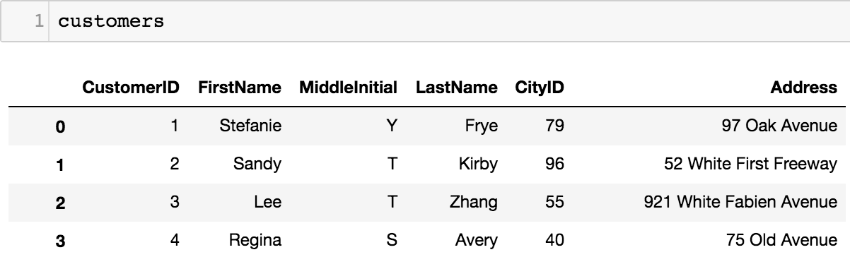
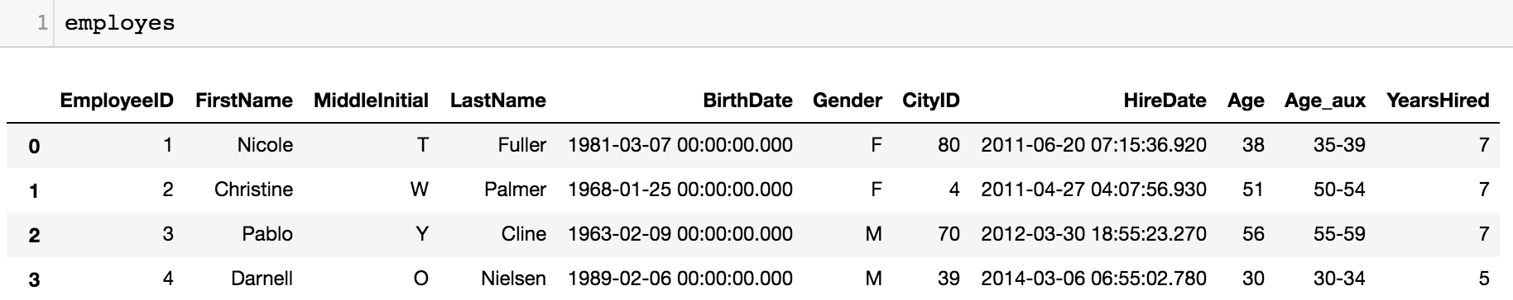
Conclusion - why it is hypothetical
Contains personal customer and employee information information
No source to where the data came from
Results of machine learning models suggest there is absolutely no relationship between parameters
Notes:
Ben

Slide 13

Difficulties, Issues, and complications
Had issues with making the proximity to holidays function using datetime.
Some data frames were incomplete and had to be merged with other data frames.
Data was too big, computers were too slow.
Notes:
Samson

Slide 14
Future Exploration
Better data
Look at profits closer
Look at geography data
Find a way to include more parameters
(as in how do we mix categorical and numerical data)
Notes:
Kieran

Slide 15
References
Vaibhav Kumar. 2018. Towardsdatascience.com. Date accessed: April 16, 2019.
ake VanderPlas. 2017. Jakevdp.github.io Date accessed: April 16,2019
Notes:
Nobody

